Slide 1

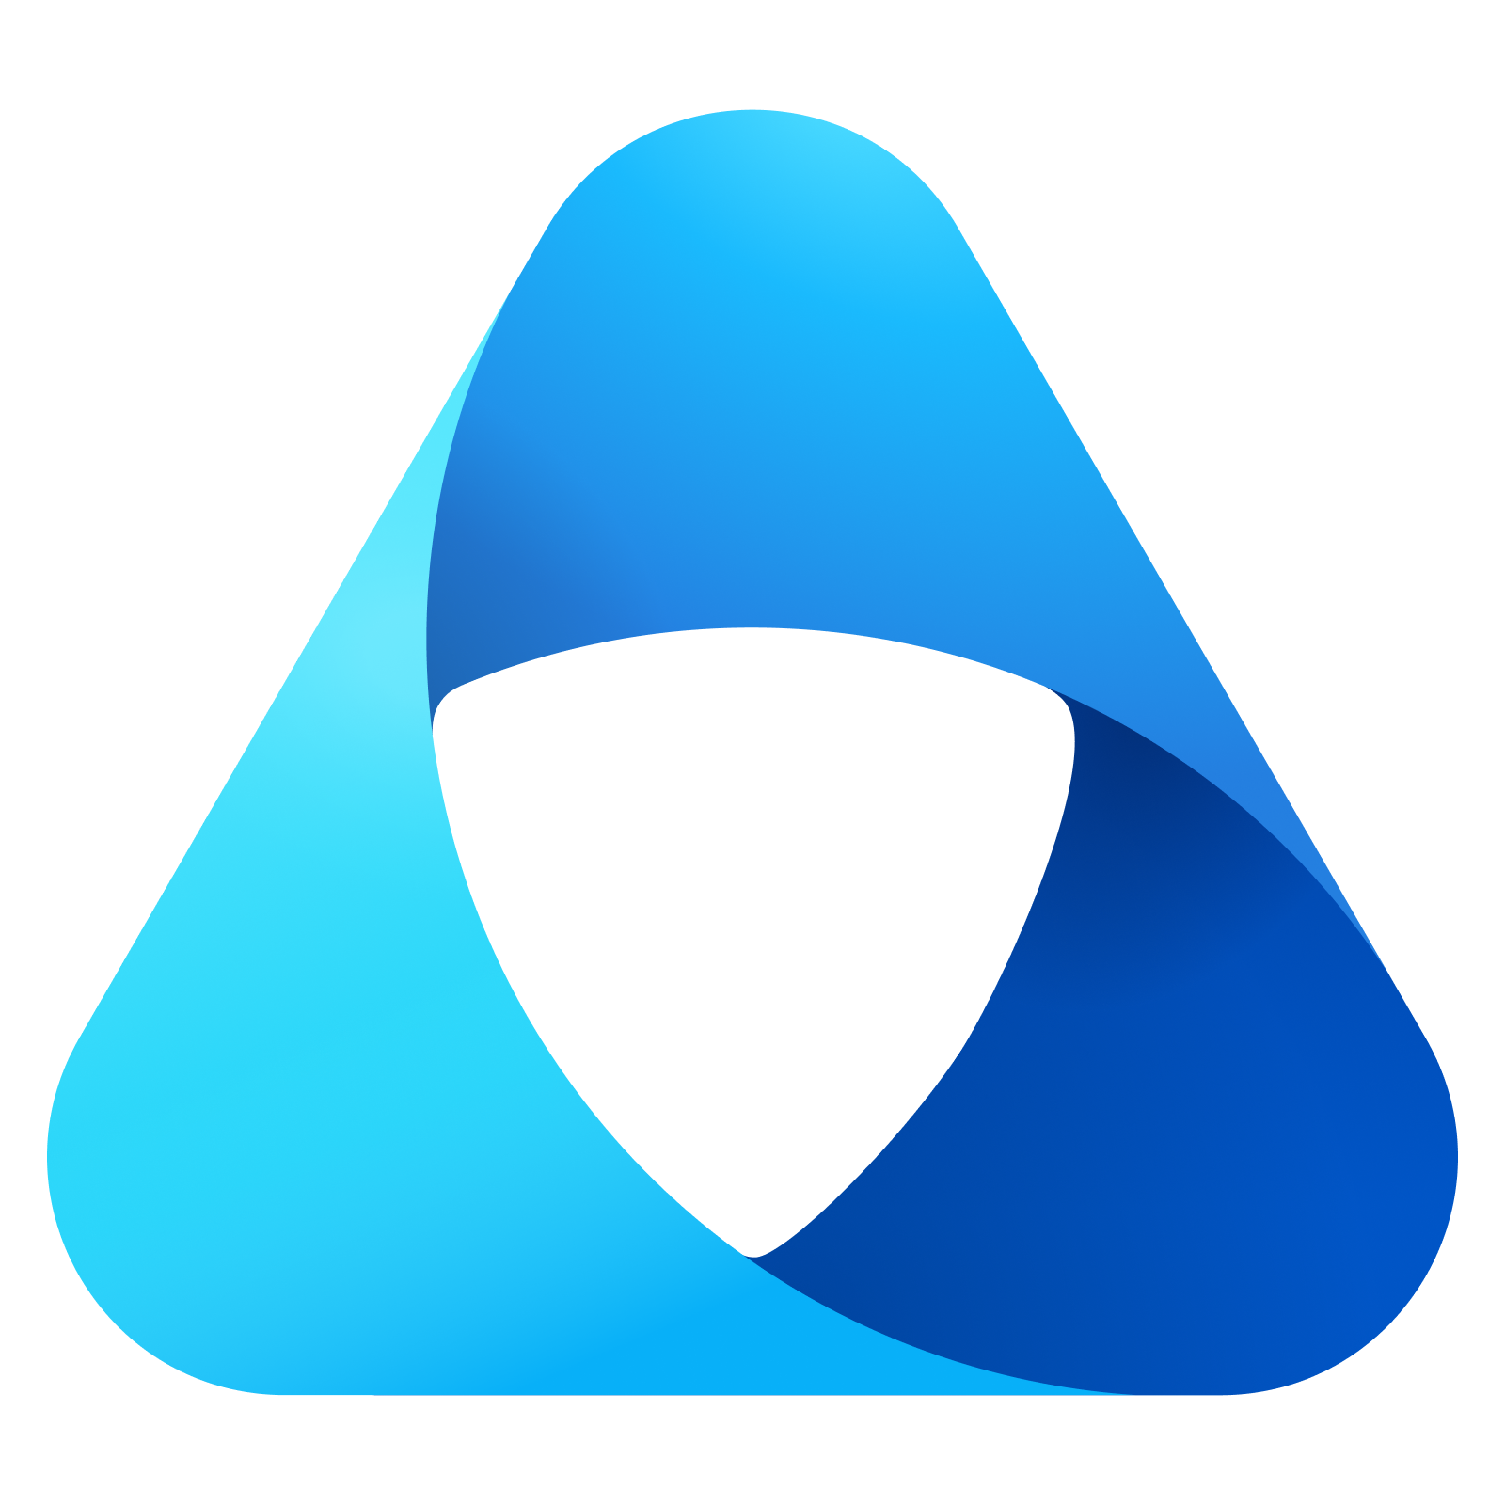
Module 5 – Governance Domains

Slide 2
Unified Catalog
Data access - quickly provide right access and enforce right use to balance safety and innovation.
Data curation - organizing, annotating, and publishing your data so that it's safely accessible, reuseable, and protected.
Data discovery - users can find the data they need for day-to-day business and innovation.
Data health - data quality standards are maintained across your estate, and there's an active data lifecycle keeping your data fresh and secure.
Data understanding - data has quality descriptors that help users understand what the data is and how it should be used.
Notes:
The new Microsoft Purview Unified Catalog experience allows you to explore and understand your data categorized by governance domains, search through AI powered copilot, and subscribe to data products that come equipped with all the data you need and the tools to safely access it. Over the last couple years we invested in a strong platform that has an inventory of all your data assets, their metadata, and their lineage so you can understand the topography of your data estate. Now we're providing better tools to manage it as it grows, and more points to surface that data to your business, to make use of it in the day-to-day.

Slide 3
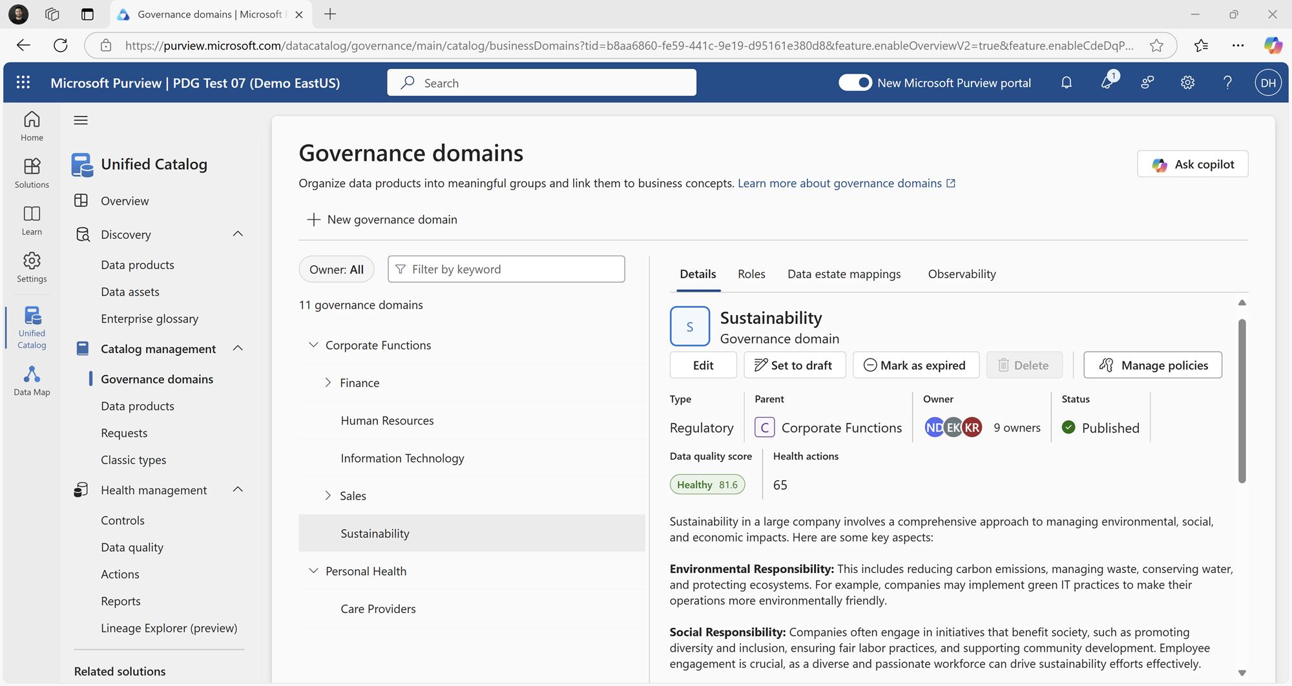
Governance Domains
The first point of federation across your organization
Enables business experts to curate and govern their domains and data
Domain owners can assign roles, types, parent domains, owners, and life cycle states, data estate mappings, and metadata
Enables policies to be inherited by assets and products in the domain
Aggregates data quality scores and help actions
3

Slide 4
Governance Domain Scenarios
GOOD
BETTER
BEST
Functional/line-of-business domains grants flexibility to teams and aligns with the existing business model. This can be difficult to manage at scale and might need many sub domains to empower data decision makers. It can also create data use silos, which is the antithesis of the data catalog's governance approach.
Domain mix:
having a combination of domains across subject areas/data domains, functional domains, regulatory domains, and project domains align your data to its experts. In the data catalog, your data experts are your most powerful resource; they know what policies need to be applied and what others need to know to make the most use of the data. This structure will also be the most durable to organizational updates, since it's based on how the data is used in the day-to-day, instead of on business structures.
Central domain using a single domain can be efficient for small organizations but might not scale well and is prone to bottlenecks during growth.
Department-based domain useful for department- based decision making however if departments regularly shift, you might need to shift your data catalog structure.

Slide 5
GOOD
Catalog
Central Governance Domain
Governance Domain
Data Product
Data Product
Data Product
Using a single domain can be efficient for small organizations but might not scale well and is prone to bottlenecks during growth.
Data Product
Data Product
Data Product
Data Product
Data Product
Data Product
5

Slide 6
GOOD
GOOD
Catalog
Department-Based Domains
Marketing
Finance
HR
Data Product
Data Product
Data Product
Useful for department- based decision making however if departments regularly shift, you might need to shift your data catalog structure
Data Product
Data Product
Sales
Operations
IT
Data Product
Data Product
Data Product
Data Product

Slide 7
BETTER
Catalog
AMERICAS_ Line of Business 1
EMEA_ Line of Business 1
Corporate
Functional Line of Business Domains
Data Product
Data Product
Data Product
Grants flexibility to teams and aligns with the existing business model. This can be difficult to manage at scale and might need many sub domains to empower data decision makers. It can also create data use silos, which is the antithesis of the data catalog's governance approach.
Data Product
Data Product
AMERICAS_ Line of Business 2
APAC_ Line of Business 1
Data Product
Data Product
7
Notes:
Functional/line-of-governance domains (better) - grants flexibility to teams, and aligns with the existing business model. This can be difficult to manage at scale, and might need many sub domains to empower data decision makers. It can also create data use silos, which is the antithesis of the Unified Catalog's governance approach.
Examples:
A multinational company like Contoso might have LOBs such as:
Retail
Manufacturing
Financial Services
Healthcare
Each LOB would have its own governance domains, data products, and policies. For example:
Retail LOB might govern customer sales data, loyalty program analytics, and supply chain metrics.
Manufacturing LOB might oversee production data, equipment telemetry, and warehouse inventory.

Slide 8
BEST
Catalog
Domain Mix
Finance
Marketing
HR
Data Product
Data Product
Data Product
A combination of domains across subject areas/data domains, functional domains, regulatory domains, and project domains align your data to its experts. In the data catalog, your data experts are your most powerful resource; they know what policies need to be applied and what others need to know to make the most use of the data. This structure will also be the most durable to organizational updates, since it's based on how the data is used in the day-to-day, instead of on business structures.
Data Product
Data Product
Data Product
AMERICAS_ Line of Business
Program 1
Project 1
Data Product
Data Product
Data Product
APAC_ Line of Business 1
Corporate
Regulatory
Data Product
Data Product
Data Product
8

Slide 9




Governance Domains Development Planning
Get Feedback
Add more sources
Add more Data Products
3
Start Small – Existing teams/stewards
Assign data steward
Data Map & Data Product
Democratize Data
1
4
Publish Governance Domain
Identify a small number of users
Grand Reader permissions on Unified Catalog
2

